Slide 1

Predicting Scope 3 Greenhouse Gas (GHG) Emissions Using Hierarchical Linear Modeling
Amber Jensen
Regis University
June 26, 2025

Slide 2

Climate Change & Greenhouse Gas
Climate Change driven by greenhouse gases from human activity.
Greenhouse gas emissions build up in the atmosphere and warm the climate.
Companies contribute harmful greenhouse gas emissions through operations and supply chain activities.
Companies can reduce greenhouse gas emissions through sustainable business practices.

Slide 3
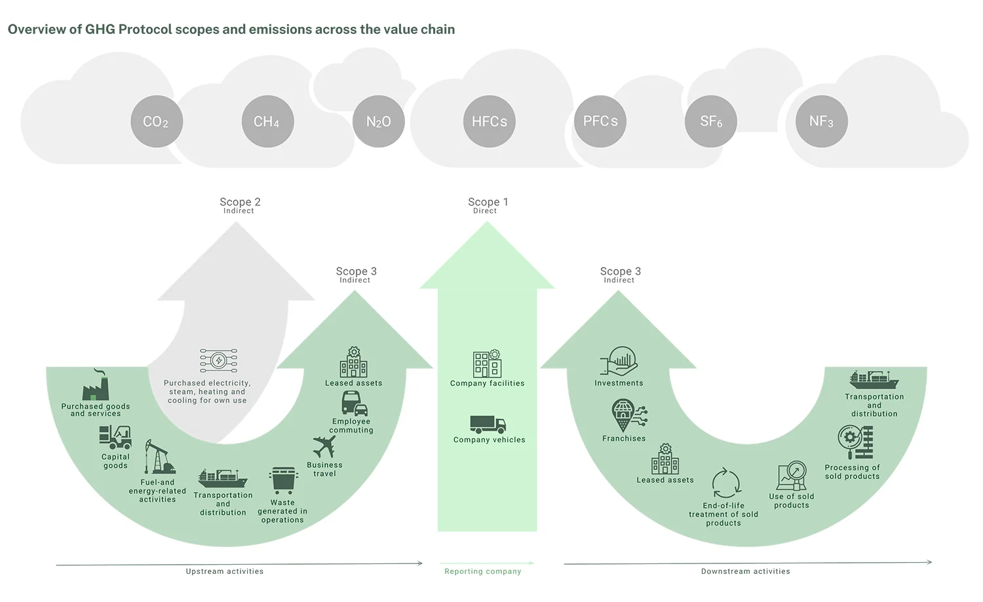
GHG Protocol Classification of Greenhouse Gases
Industrial Sustainability Solutions (https://industrialsustainabilitysolutions.com/scope-3-emissions-reporting-guide/)

Slide 4
Why Scope 3 Emissions Matter
Scope 3: largest, hardest to measure; Scopes 1 & 2 are easier to quantify
Increasing regulations requiring Scope 3 reporting
Complex value chains and inconsistent reporting complicate Scope 3 data
Difficult to gather data

Slide 5

The Data
Carbon Disclosure Project dataset included self-reported emissions data from 2013-2023, from nearly 8,800 companies from over 110 countries
Financial data from Financial Modeling API was incorporated with emissions data.
Hierarchical structure of the data – grouped by Scope 3 emissions source, industry, primary activity reported by year.
Complex Dataset

Slide 6

Data Cleaning & Preparation
Outlier , duplicate entries and 0 value Scope 3 Emissions removed
Feature engineering (year²)
Data split into 17 separate datasets by Scope 3 emissions type
Evaluated for multicollinearity
Train/test split at company level by year
Signed log transformations to normalize data

Slide 7
Existing Models from Literature used for Scope 3 Emissions Estimates
Baseline Models (Industry Fill, Naïve OLS): Oversimplified and ignore company or industry specific factors, resulting in higher errors.
Linear Models (OLS, GLM, Stepwise, Full OLS): Do not capture non-linear patterns and are generally less accurate than advanced models.
Advanced Machine Learning Models (KNN, Random Forest, AdaBoost, Linear Forest): Improved accuracy over simpler models. Ensemble methods (RF, AdaBoost) often perform best, but results depend on data quality.
Third-Party Toolboxes: Often lack transparency and independent verification.

Slide 8

Why use Hierarchical Linear Models (HLM)?
Designed for Clustered Data
Accounts for Group Similarities
Analyzed Multi-Level Influences and Variation
Novel Approach

Slide 9

Hierarchical Linear Model Methodology
Stepwise Model Development
Null model (random intercept)
Two-level (time trends)
Three-level (company & primary activity grouping)
Full model (all features)
Optimized model (significant features only)

Slide 10
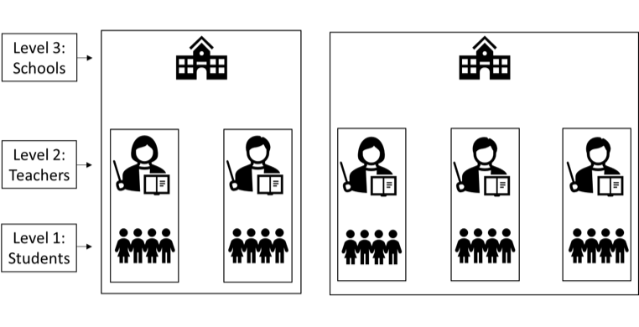
Null, Two-Level, and Three-Level
Null Model: Models individual emissions observations (level-1), grouped by company (level-2). Each company has its own random intercept or baseline emission level.
Two-Level Model: Models individual company emissions observations (level-1) and grouped by company (level-2). Adds fixed effects of Year and Year_sq time trends to capture trends over time.
Three-Level Model: Each primary activity (level-3) has its own random intercept baseline, each company (level-2) nested within primary activity has its own random intercept baseline, and the effects vary by time (level-1), which provides the random slope. This captures the variation of primary activity, company and time within company levels.
https://www.statisticssolutions.com/what-is-hierarchical-linear-modeling/

Slide 11
HLM Full Mixed Effects Model
formula = {Scope_3_emissions_amount_slog} ~ {'Market_Cap_USD_slog’ + 'Revenue_USD_slog’ + ’ebitda_USD_slog’ + ‘grossProfit_US_slog’ + ‘netIncome_USD_slog’ + ‘cashAndCashEquivalents_USD_slog’+ ‘shortTermInvestments_USD_slog’ + ‘longTermInvestments_USD_slog’ + 'totalAssets_USD_slog’ + 'totalLiabilities_USD_slog’ + 'totalInvestments_USD_slog’ + 'totalDebt_USD_slog’ + 'totalEquity_USD_slog’ + 'scope_1_2_emissions_amount_slog’ + C(Countries) + C(Primary_activity) + Year}
Target variable: sign-log transformation of Scope 3 emissions
Financial predictors and Scope 1&2 emissions are sign-log transformed to normalize, address skew and stabilize model fit
Categorical fixed effects for country and primary activity, and year included.

Slide 12
HLM Full Mixed Effects Model – Random Effects
md = smf.mixedlm(formula, data=train_df_full, groups=train_df_full['account_id'])
Random effects capture differences between companies not explained by other factors
A random intercept lets each company have its own baseline emission level by grouping on ‘account_id’
Random slopes allow the effect of a predictor to differ for each company or defined group.

Slide 13
HLM Optimized Mixed Effects Model
The optimized Mixed Effects Model includes only significant features with positive, non-zero effects
The formula is simplified compared to the Full Model formula
Results show how model complexity increases accuracy and highlights the most important factors influencing Scope 3 emissions.
formula = {Scope_3_emissions_amount_slog} ~ {'Market_Cap_USDslog’ + ‘totalAssets_USD_slog’ + 'totalLiabilities_USD_slog’ + ‘scope_1_2_emissions_amount_slog'+ C(Countries) + C(Primary_activity) + Year}
md = smf.mixedlm(formula, data=train_df_opt, groups=train_df_opt['account_id'])

Slide 14
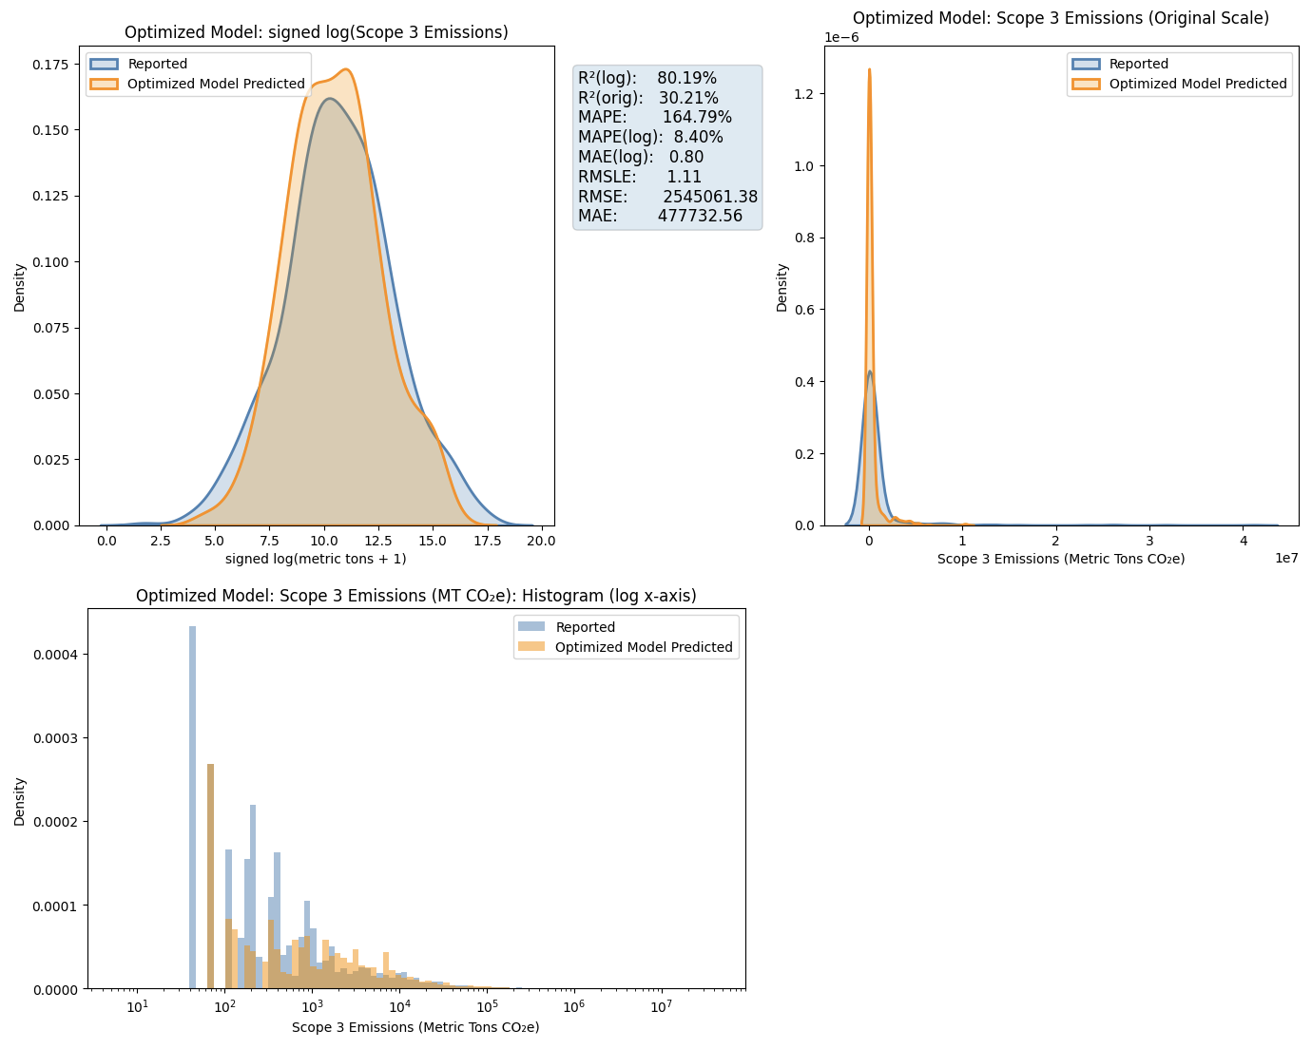
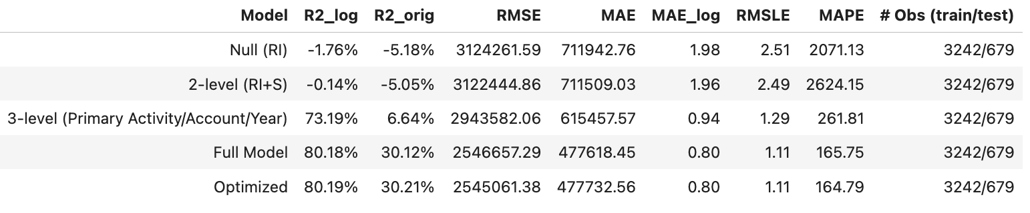
Model Outputs
Fuel Energy Scope 3 Source
Optimized Model Output

Slide 15
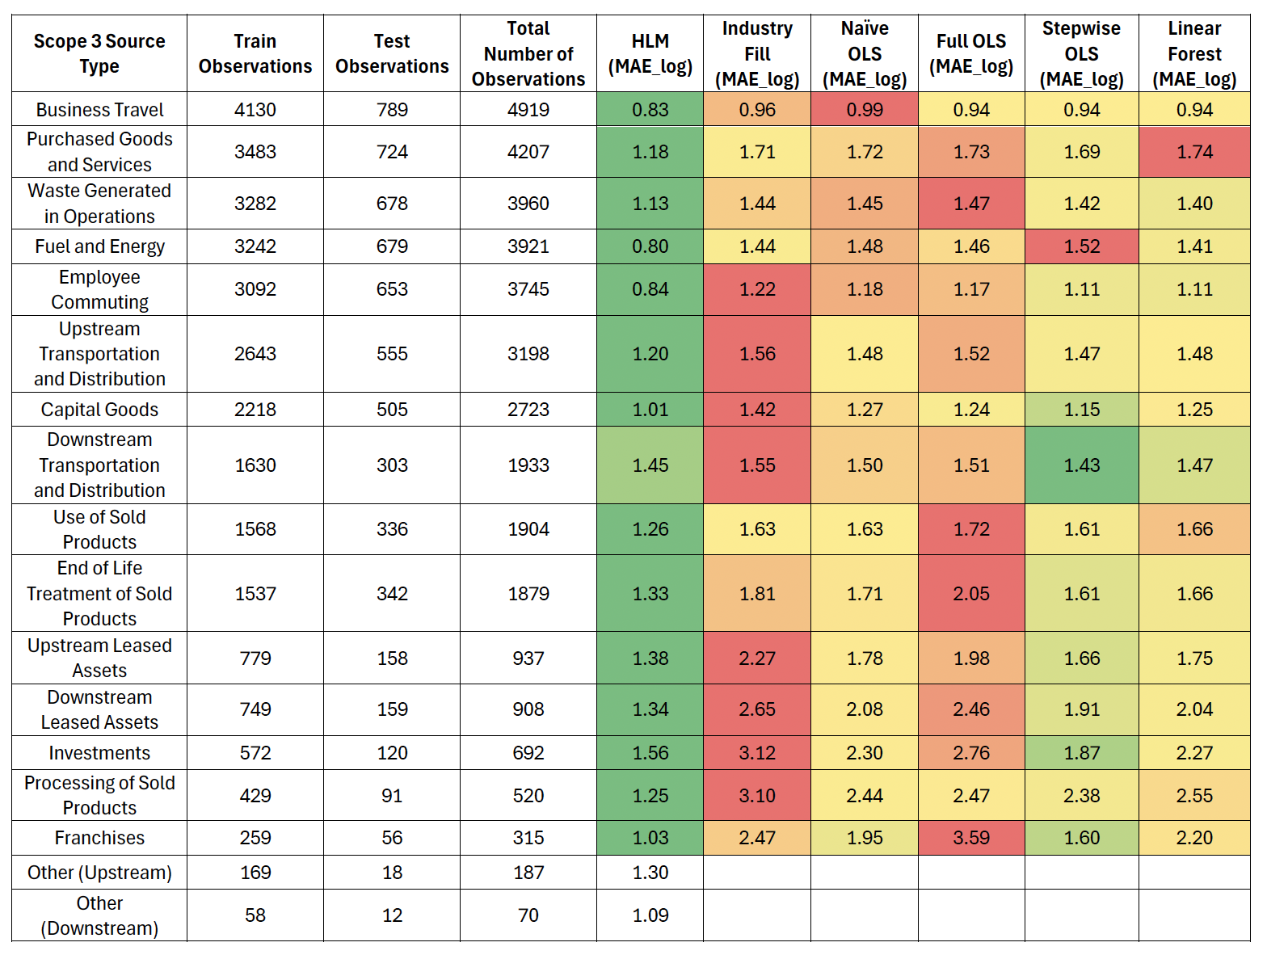
Key Results
Optimized HLMs MAE_log Comparison
HLM has lowest MAE_log in most categories.
Simpler models show higher errors.
OLS and Linear Forest models don’t match HLM.
HLM excels with more data and handles sparse categories.
(Nguyen et al., 2023)

Slide 16
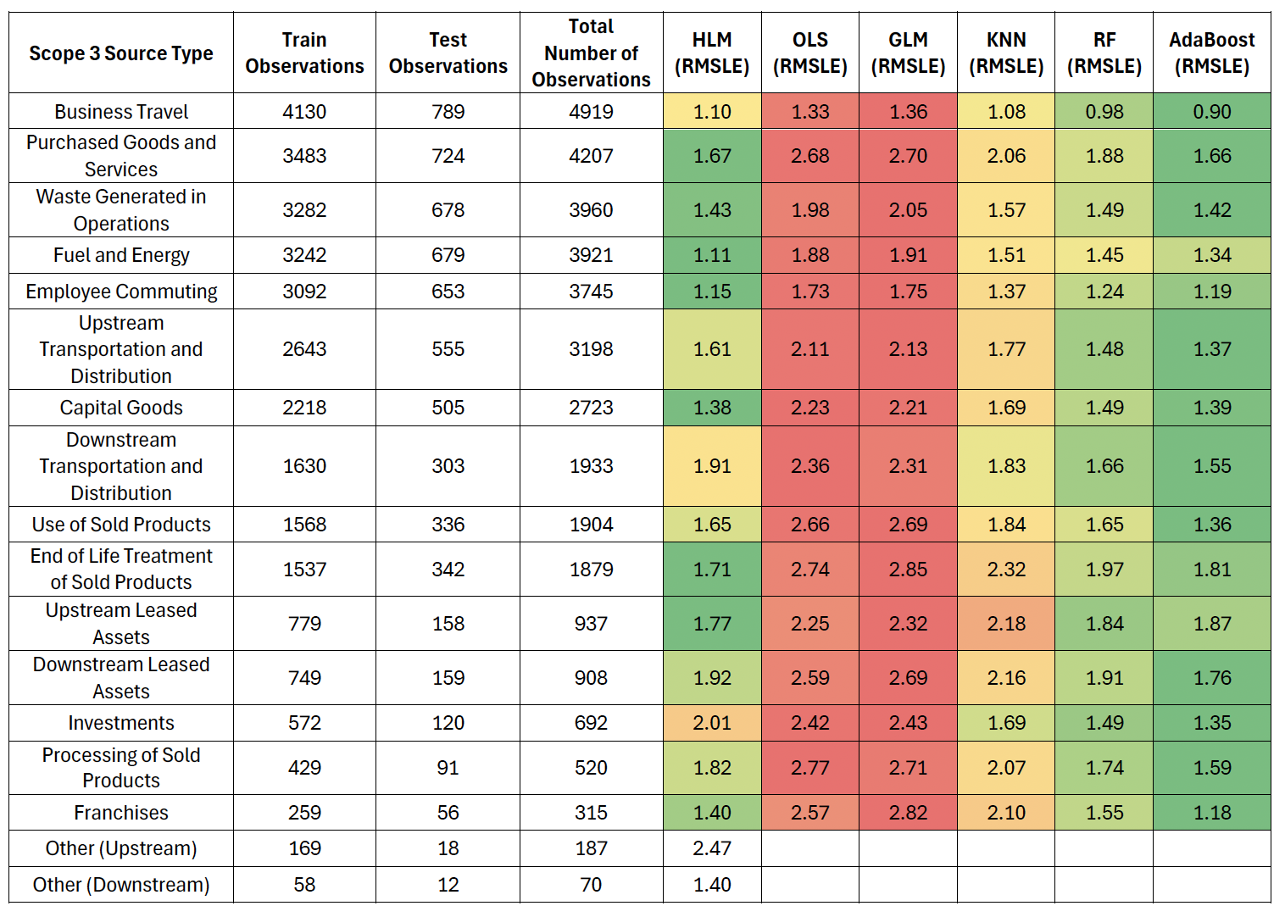
Key Results Continued
Optimized HLMs RMSLE Comparison
HLM able to achieve lower RMSLE vs. OLS/GLM.
Random Forest and AdaBoost are comparable or better than HLM.
Simpler models (OLS, GLM, KNN) have higher errors overall.
(Serafeim & Velez Caicedo, 2022)

Slide 17
Robustness & Missing Data
Assessed the impact of missing data on HLM model performance.
Compared models with removed vs. KNN-imputed missing values.
Removing missing data gave higher R² and lower error.
KNN imputation introduced bias, reduced variability, and masked trends.
HLM models proved robust to missing data.
Scope 3 Source Business Travel | Train | Test | All Observations | Model | R²_log | R²_orig | RMSLE
Missing Values Imputed | 5016 | 1034 | 6050 | Optimized | 53.77% | 27.38% | 1.31
Missing Values Removed | 4130 | 789 | 4919 | Optimized | 60.55% | 40.38% | 1.1

Slide 18

Conclusions
This study has shown the novel application of Hierarchical Linear Models to the analysis and prediction of Scope 3 emissions.
Hierarchical Linear Models can be used to provide robust estimates of Scope 3 emissions, but further refinement is needed to increase accuracy.
Study methods of estimation to address convergence issues and increase model performance
Investigation into clustering and Principal Component Analysis

Slide 19
References
Carbon Disclosure Project. (2023). Carbon Disclosure Project. Cdp.net. https://www.cdp.net/en
EPA. (2024, June 27). Climate Change Indicators: Greenhouse Gases. US EPA; United States Environmental Protection Agency. https://www.epa.gov/climate-indicators/greenhouse-gases
Financial Modeling Prep - Financial Data API. (2017). Financial Modeling Prep. https://site.financialmodelingprep.com/developer
Gibson, K. (2024, July 11). How Businesses Can Measure & Reduce Carbon Emissions. Business Insights Blog; Harvard Business School. https://online.hbs.edu/blog/post/how-to-reduce-carbon-emissions
NASA. (2024, October 23). The Effects of Climate Change. Science.nasa.gov; NASA. https://science.nasa.gov/climate-change/effects/
Nguyen, Q., Diaz-Rainey, I., Kitto, A., McNeil, B. I., Pittman, N. A., & Zhang, R. (2023). Scope 3 emissions: Data quality and machine learning prediction accuracy. PLOS Climate, 2(11), e0000208. https://doi.org/10.1371/journal.pclm.0000208
Serafeim, G., & Velez Caicedo, G. (2022). Machine Learning Models for Prediction of Scope 3 Carbon Emissions (SSRN Scholarly Paper No. 4149874). Social Science Research Network. https://doi.org/10.2139/ssrn.4149874

